Slide 1


Deloitte Audit QA Hackathon
Total Time allotted – 20 mins
Bug Busters
Notes:
The training doesn’t stop today
Brand Space has a growing library of training topics to help upskill you on key topics.
Ranging from recorded sessions like these that are hours long to 10 minute micro trainings on niche system topics, you’ll find the topics you want with the level of detail you desire

Slide 2
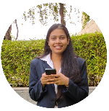
Team Members
Gupta, Ismriti
Frontend Developer (InK)
Patalay, Archana
Quality Assurance (InK)
Gouthami, Gouthami
Quality Assurance (Leviva)
Dhar, Akanksha Dhar
Full Stack Developer in (InK)

Slide 3

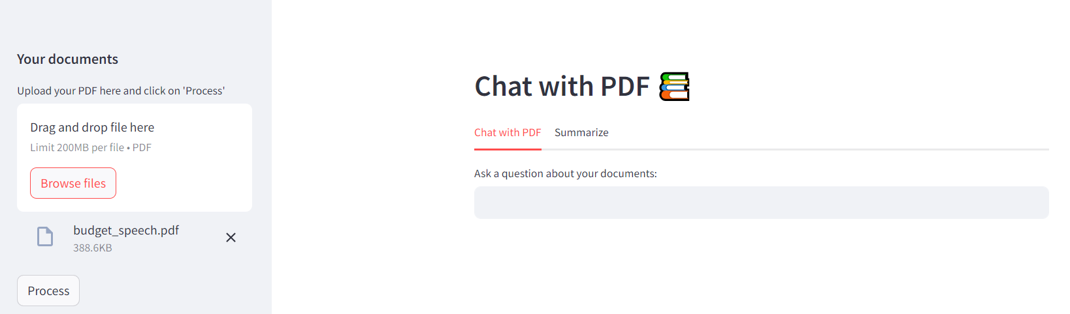




Chat with PDF
Solution Overview / Technical Approach
Chat with PDF is a LLM based pdf chatbot that can swiftly extract, find and summarize the information from the selected source documents. It provides user an interface to ask questions based on the uploaded PDF and summarize a part of text in bullet points.
Model: Hugging Face LLMs
UI: Streamlit
Vector Store: Pinecone
Editor: Visual Studio Code
google/flan-t5-base, LaMini-Flan-T5-248M
Technology
Stack
Total Time allotted – 3 min

Slide 4






Chat with PDF
Solution Architecture
1 0 0 1 0
0 1 0 1 0
Question Embedding
Answer
Semantic Search
LLM
1 0 0 1 0
0 1 0 1 0
Chunk of the document
Embeddings
1 0 0 1 0
0 1 0 1 0
Chunk of the document
Embeddings
Ranked Results
1 0 0 1 0
0 1 0 1 0
Chunk of the document
Embeddings
Vector Store
(knowledge base)
Total Time allotted – 3 min

Slide 5
Chat with PDF
Demo
Total Time allotted – 5 min

Slide 6
Chat with PDF
Challenges/Limitation/Improvement Areas
Challenges Faced
Future Scope of existing Solution
Training LLMs on CPU instead of GPU
Storing Vector Embeddings
Cost of Tools, Subscription of Models
Reading assistant for multiple pdfs
Summarizing text from different languages into English Language
Train model on chat history to get better responses
Make chatbot more conversational
Query against excel files
Improvement Areas
Using latest state of the art models
Running LLMs on GPU
Increased dimensions in indexing for better semantic results
Parameter Efficient Fine Tuning
Total Time allotted – 3 min

Slide 7
Talk to Doc
Q & A
Thank You
Total Time allotted – 5 min

